Slide 1
Gourmet in Bristol
Applied Data Science Capstone
Alex Aklson, Ph.D., Data Scientist
Amodio Savio
Notes:
We designed this template so that each member of the project team has a set of slides with its own theme. Members, here’s how you add a new slide to just your set:
Mark where you want to add the slide: Select an existing one in the Thumbnails pane, click the New Slide button, then choose a layout. The new slide gets the same theme as the other slides in your set.
Careful! Don’t annoy your fellow presenters by accidentally changing their themes. That can happen if you choose a different theme from the Design tab, which changes all of the slides in the presentation to that look.

Slide 2
Agenda / Topics
Project Description
Project Methodology
Key Findings/Results
Research drilldown
Conclusion

Slide 3
Project Description
Objective
A famous chef of Italian Cuisine wants to open a 5 stars restaurant in Bristol and he wants to collaborate with nearby restaurant of different cuisine.

Slide 4
Procedure/Methodology
Procedure
collecting data from several resources
define mean / percentile of available data
apply clustering to the list of neighbourhoods
Key assumptions
The restaurants taken in account have price 3,4

Slide 5
Supporting content
data.opendatasof.com
Wards polygons
Lsoa polygons
Plumplot.co.uk
Average House Price in Bristol
Foursquare
Restaurants
Doogal.co.uk
Wards
Lsoa
Postcode
Index deprivation
Average Income
Wikipedia/Wikimedia
Bristol Neighbourhoods

Slide 6
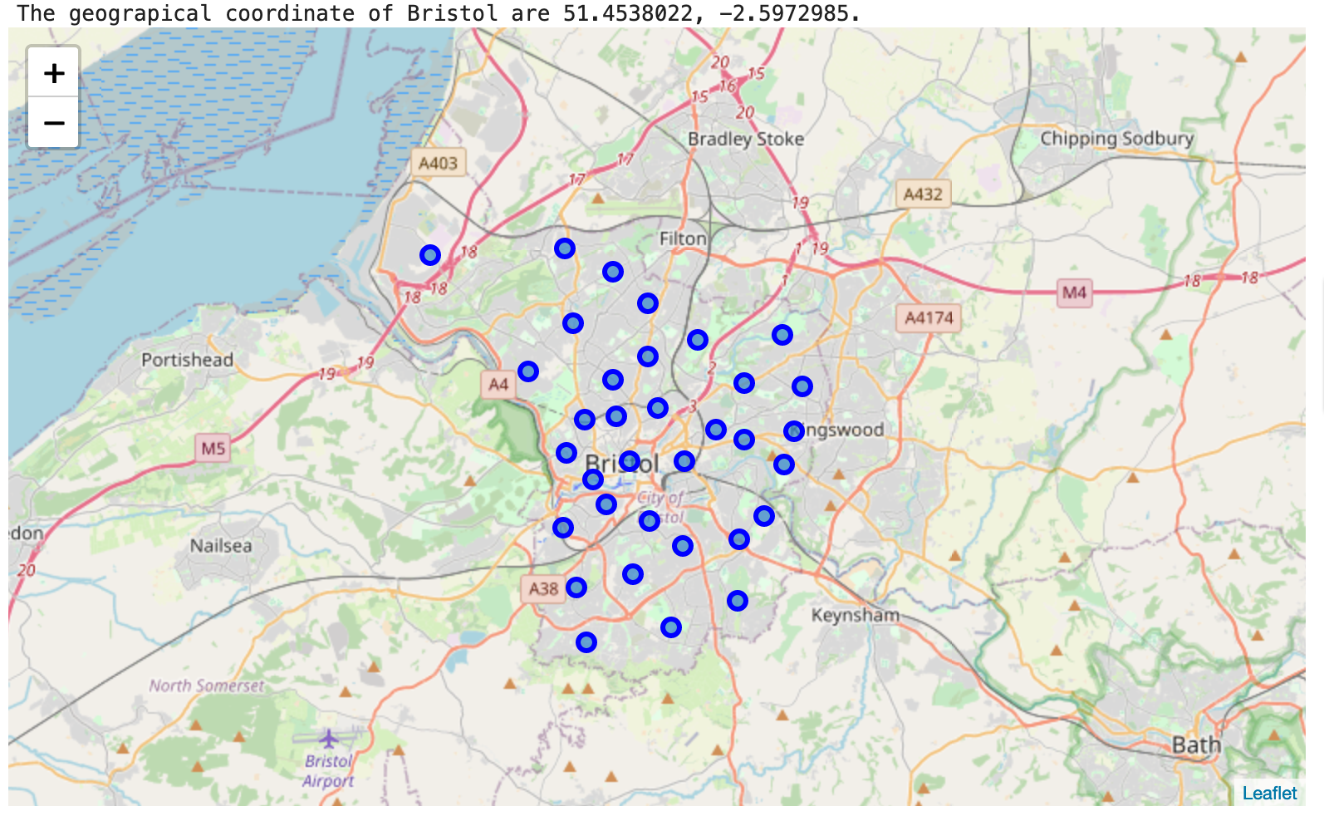
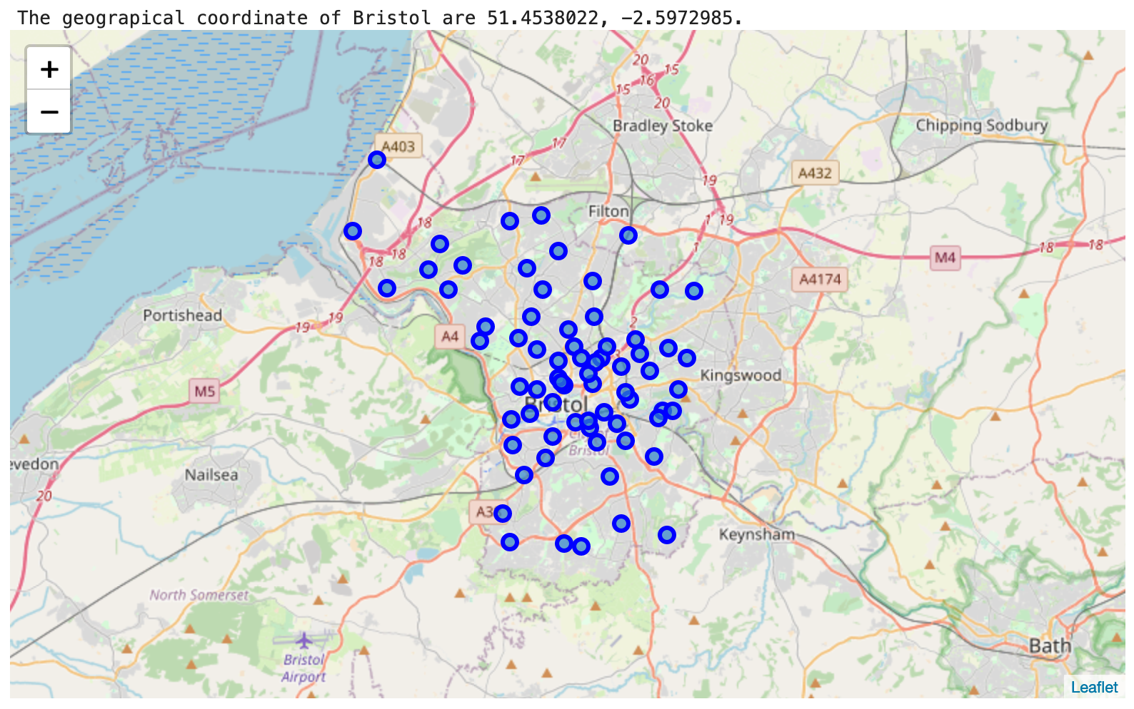
Data observations
Neighbourhood centroids (~70)
Ward centroids (~30)

Slide 7
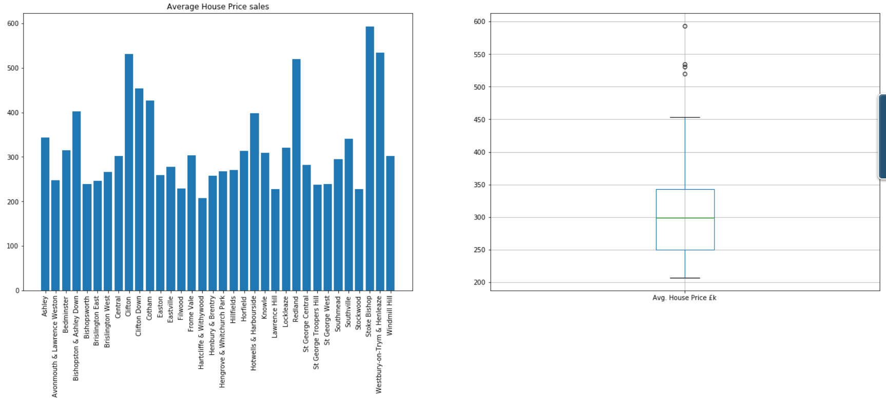
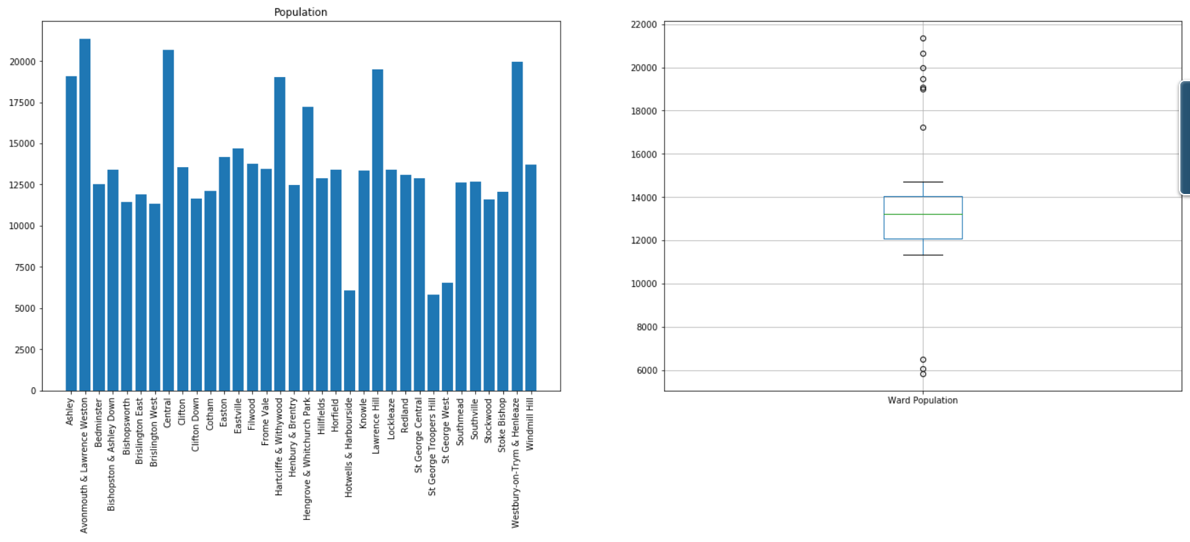
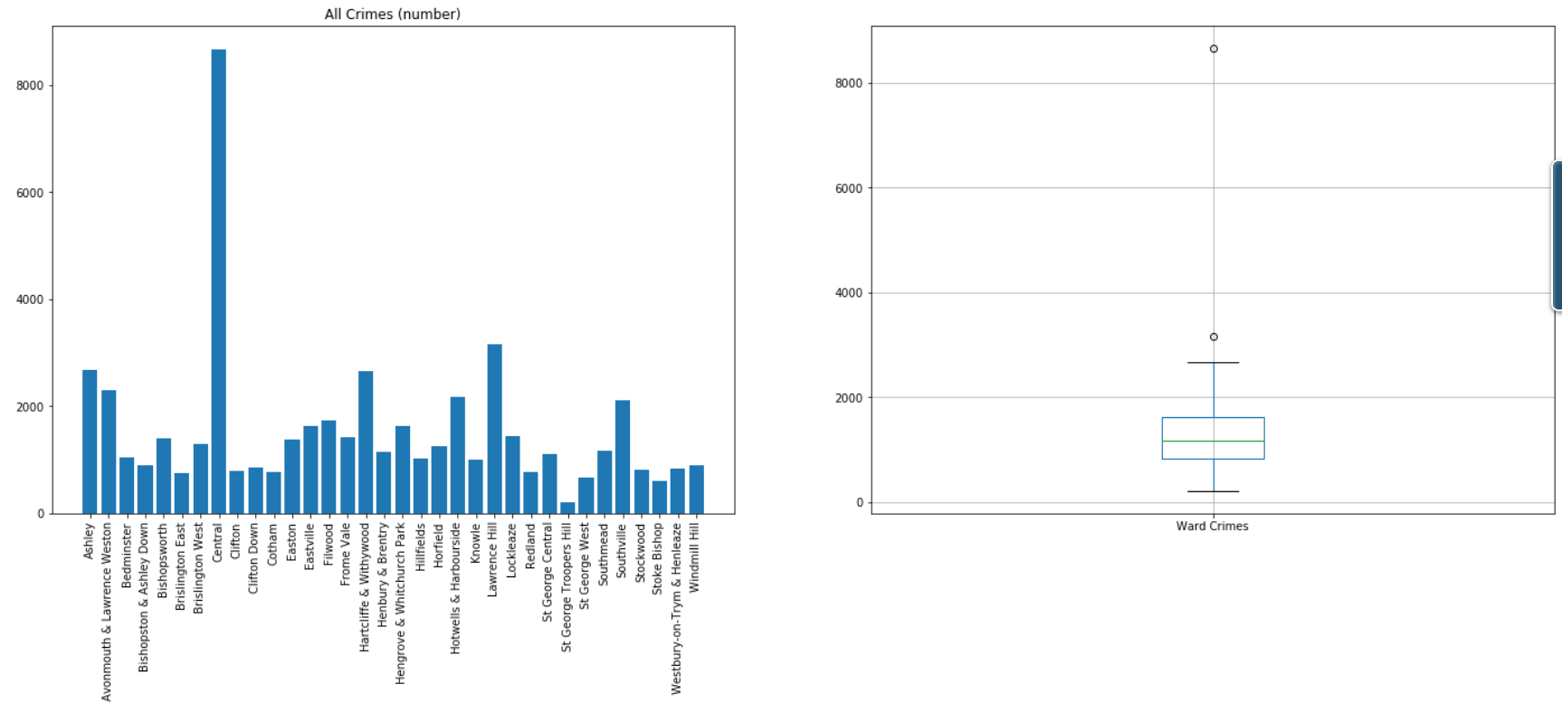
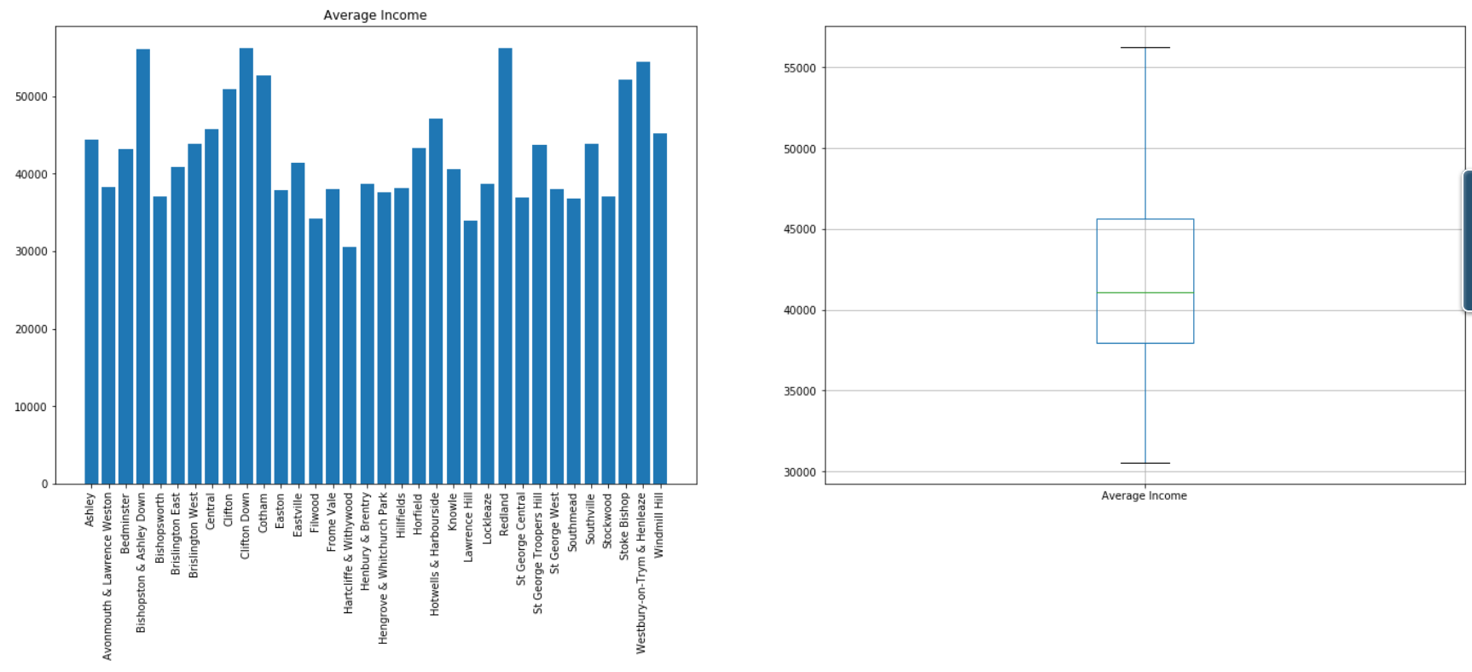
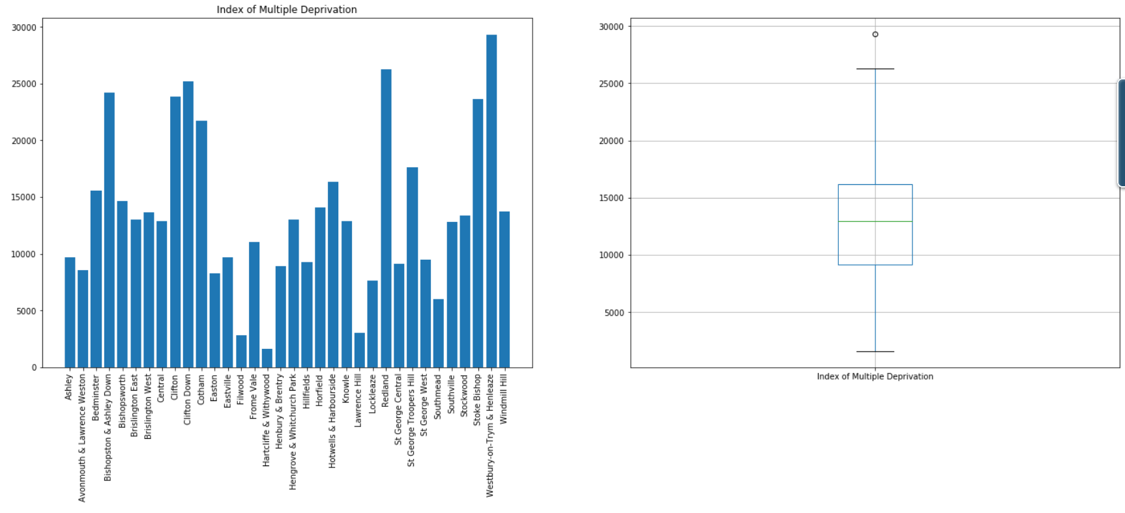
Data observations
Main characteristics take in account for each ward:
Average of House price
Crimes
Average Income
Population
Index of deprivation

Slide 8
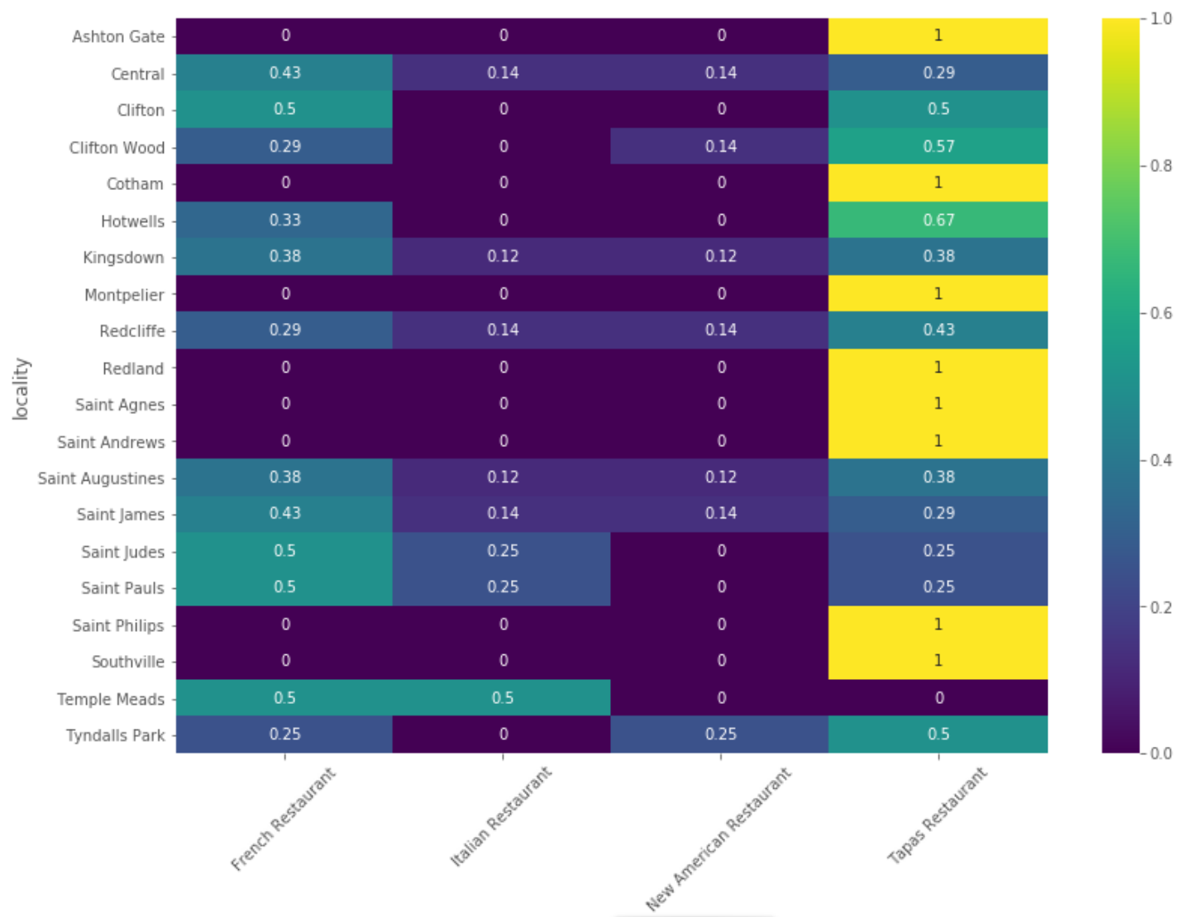
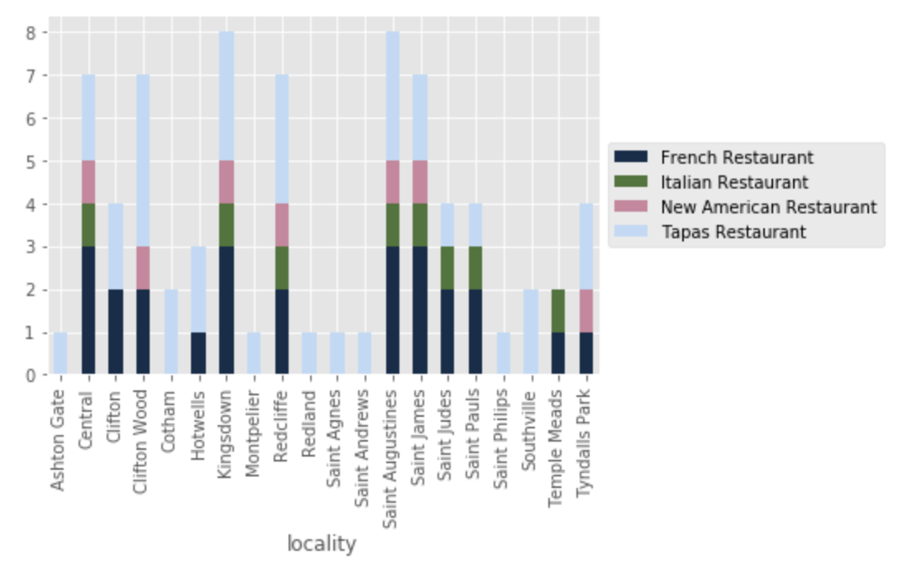
Data observations
After fetching the restaurant from Foursquare (specific filter price = 3,4) for each neighbourhood

Slide 9
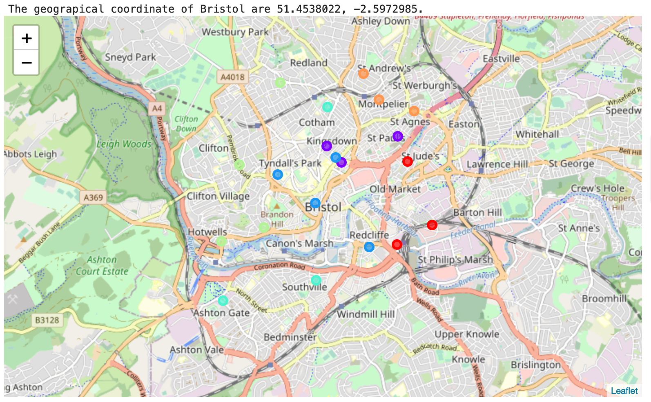
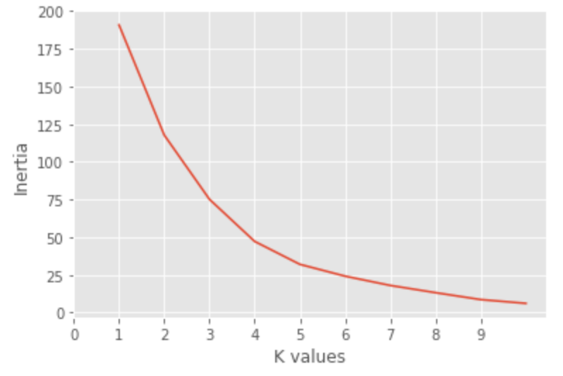
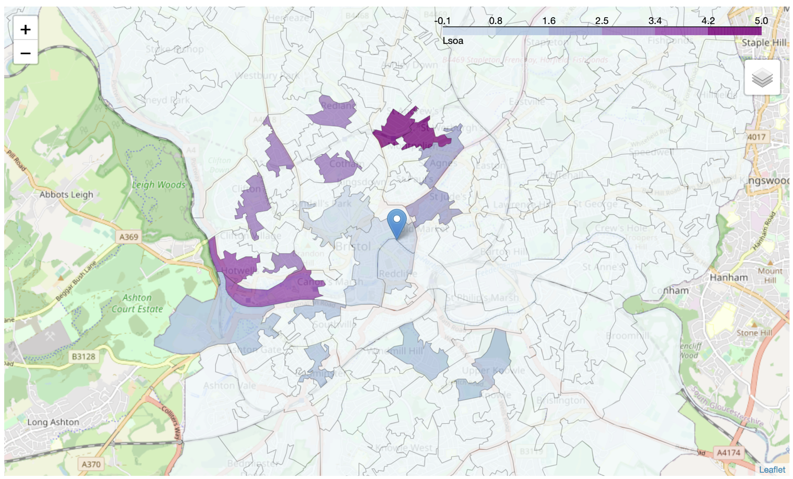
Data observations
Clustering with KMeans
k = 6 as trade off value for identifying the clusters

Slide 10
Data observations
Clusters:
One of characteristic of the cluster 1 is to gather neighbourhood with high population but with high crimes and most of them have highly diversity cuisine.
The cluster 2 has a bad diversity of restaurant but the crimes are very low.
The cluster 3 has neighbourhoods highly populated and the deprivation is high.
The cluster 4 highlights neighbourhoods quite rich and the quality of live is high: low crime, very good income, low deprivation, the population is in the average, but only one of them it's interesting Cliftonwood because the only one with high restaurant diversity and additional there is not competitor for our Italian Chef.
The cluster 5 is highly populated and house / income / deprivation are in the average, low crime but only few diversity restaurant.
The cluster 6 has basically only one type of cuisine Tapas Restaurant, the population is low, good in crimes and the average for the rest of variables.

Slide 11
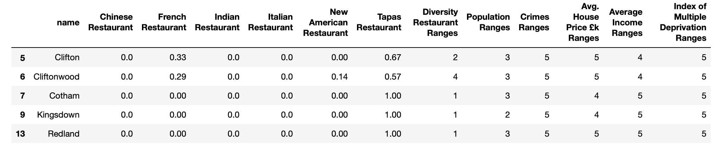
Data observations
Cluster n.4

Slide 12
Conclusion
After applying the clustering, a couple two cluster can be identified as suitable for the satisfy the requirement of chef, the first one is gathering

